Slide 1
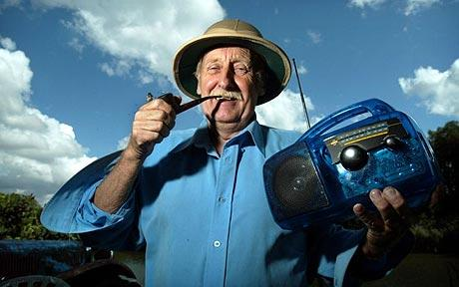
Lifeline energy
Trevor Baylis, 1991 invented wind-up radio
Less than 20% of world population has access to communication, plus power supply problem
Experimented with old wind-up telephone technology, developed a wind-up radio
Prototype gave 14 minutes power for a 2 minute wind

Slide 2
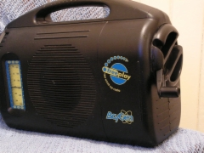
Wind up radio

Slide 3
Early stages
4 years unsuccessful approaches to major manufacturers like Philips
1994 lucky break, TV exposure on ‘Tomorrow’s world’
Viewers included Chris Staines (financier) and Rory Steer (entrepreneur) who bought the rights
UK government grant to develop product

Slide 4
Early stages (2)
Developed product further, added solar panel
Seen in South Africa by Hylton Applebaum, head of Liberty Life Foundation, who saw potential for application there
Liberty Life (Anita Roddick, The Body Shop) provides employment for disabled people
$1.5m venture capital to set up Baygen Power Industries, 1995

Slide 5
Baygen Power Industries
Cape Town based, 60% shareholding by disabled organizations
Technical support from Bristol University, UK
1996 reached market, 160,000 sold in first year
Main customers were aid agencies, e.g. in Rwanda

Slide 6
The product….
, "It is no threat to a Sony Walkman. It weighs six pounds, it's built like an overstuffed lunch box, and it has a tinny speaker. But its wholesale price is only $40 and it gets AM, FM, and shortwave, meaning it can pick up the British Broadcasting Corporation or the Voice of America, so a circle of mud huts can zip back into the Information Age with a twist of the wrist’
(Source(s): Donald G. McNeil Jr., New York Times News Service, 1996)

Slide 7
Next steps
More exposure and publicity – e.g. TV with Nelson Mandela in UK
Continued product development – 13 patents by Baylis, extend product range to torches
1997 recognised overdependence on aid agencies and grants, took on GE as shareholder
1999 renamed Freeplay Energy Group

Slide 8
Growing up
By 2001 harder commercial edge, took tough decision to close Cape Town factory and relocate production to China
Commercially successful, 3 million units sold, $45m of additional capital raised
Product range extended to sustainable energy – radios, torches, solar cells, micro-generators
Example – the Lifeline radio, 10m sold since 2003

Slide 9
The Lifeline radio
‘designed specifically for providing dependable access to information across a broad range of humanitarian projects. The radio does not require batteries or mains electricity and can used practically anywhere. Engineered to operate in the harshest of rural conditions, it is rugged, robust and easy to operate. It offers excellent FM/AM/SW reception and runs on wind-up energy and solar power. Fully charged, it can play for up to 24 hours ‘

Slide 10
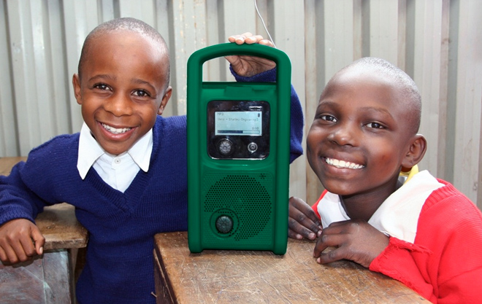
Lifeline Energy
Changed name again in 2010 to Lifeline Energy
‘to develop a range of practical, fit-for-purpose products using innovative and appropriate technologies and distribution approaches that the poor can apply to their daily lives.’
fewer than 5% of the 500 million people living in rural sub-Saharan Africa have access to any form of electricity

Slide 11
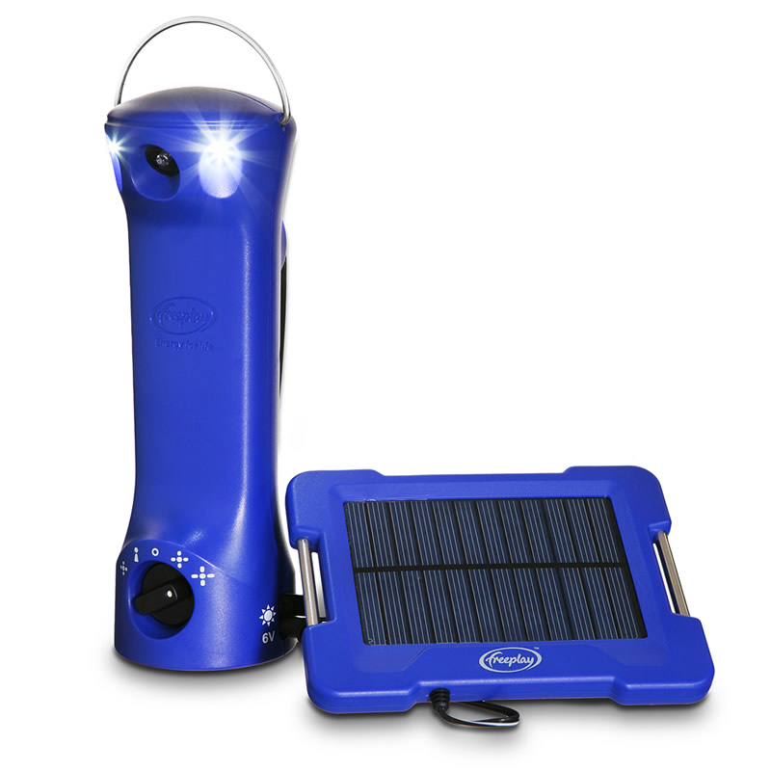
New products
Lifelight – simple LED light source, replaces dangerous fire risk options
‘ it is tragic that in 2010, well over 100 years after the invention of the light bulb, millions of people in the developing world are still in the dark at night’

Slide 12
Scale and sustainability
‘researching and assessing what the extremely poor want and need; creating fit-for-purpose products that people can afford; and then, ensuring their distribution through various channels including the ability for women to earn income and create jobs by selling or renting lights and providing charging services to those without electricity.’

Slide 13
Business model
Still dependent on aid and other income sources, moving to more commercial basis
Potential for ‘reverse technology transfer’, selling in developed country markets
For example LED lighting and torches, mobile phone chargers, micro-generators

Slide 14
Lifeline Energy today
http://www.lifelineenergy.org/mediacentre_videos.html

